Slide 1


What drives merger waves?
Jarrad Harford | JFE, 2005

Slide 2
Does market timing or industry shock drive merger waves?
WSU
Research Question
Market Timing
Rational managers take advantage of consistent pricing errors in the market to buy real assets with overvalued stock
Industry Shock(s)
Industries responding to shocks reorganize through mergers and acquisitions, thereby creating a clustering of merger activity
Merger waves are most likely when an industry shock had resulted in spare capacity (slump in demand)
- Gregor Andrade and Erik Stafford
Regulatory shocks are important, too; the shock of deregulation led many deals in the late 1990s
Harford looks at 35 merger waves in 28 industries between 1981 and 2000 → Even if a shock has occurred, managers still need to raise money for a merger (debt or cash).

Slide 3


Neoclassical Explanation
WSU
Hypotheses
“Neoclassical explanations of rational merger waves are based on an economic disturbance that leads to industry reorganization.”
This paper suggests a role for capital liquidity within a neoclassical hypothesis
Harford argues that because higher market valuations relax financing constraints, market valuations are an important component of capital liquidity
Harford (1999) shows that firms that have built up large cash reserves are more active in the acquisition market
Under the neoclassical hypothesis, once a shock to an industry’s environment occurs, the collective reaction of firms inside and outside the industry is such that industry assets are reallocated through mergers and partial-firm acquisitions

Slide 4
Behavioral Hypothesis
WSU
Hypotheses
“Under the behavioral hypothesis, there is no underlying reason for a merger wave other than the desire by managers to use overvalued stock to acquire the assets of less overvalued firms.”
Shleifer and Vishny (2003) posit that bull markets lead groups of bidders with overvalued stock to use the stock to buy real assets of undervalued targets through mergers. --- shorter time horizon
Rhodes-Kropf and Viswanathan (2004) argue that rational targets without perfect information will accept more bids from overvalued bidders during market valuation peaks because they overestimate synergies during these periods. --- imperfect information
Rhodes-Kropf et al. (2004) note that their results are consistent with both behavioral mispricing stories → ergo, merger activity spikes when growth opportunities are high or when firm specific discount rates are low
This interpretation is similar to a neoclassical hypothesis with a capital liquidity component.

Slide 5

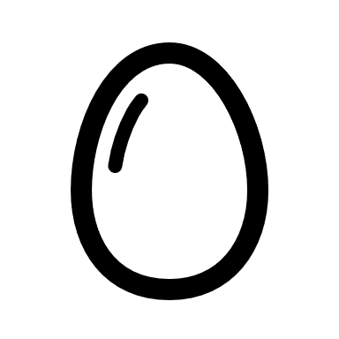
Behavioral Prejudices?
WSU
Georgetown Law
“What has become clear for both descriptive and normative analysis is that incorporating insights from psychology into corporate and securities law means having to climb four tall steps to gain plausibility.”
- The Behavioral Economics of Mergers and Acquisitions (Langevoort, 2011)

Slide 6
Joint Hypothesis Problem
WSU
Data (SDC 1981-2000)
“Due to the changes the industry is undergoing and the endogeneity of the choice to merge, the contemporaneous performance of the industry also is a problematic proxy.”
All firms are likely to restructure in some way (either externally or internally) in response to the industry shock (no differences)
The neoclassical hypothesis predicts that performance will improve relative to the unobservable unmerged performance (only relative to what would have happened, similar to RDD)
Any empirical test of this hypothesis implicitly tests the joint hypothesis
That the empirical benchmark is a good proxy for the unobservable benchmark
That performance improves relative to this benchmark
Harford uses both industry benchmarks and analysts’ forecasts (pre and post merge)
Behavioral Framework – Mergers in waves have no underlying economic rationale
A presumption that regulatory necessity is a catalyst for better performance… what about in a crash? (e.g., “Black Monday”)

Slide 7
The Proper Macro Environment
WSU
Results
“Thus, the explanation for merger waves is intuitive: merger waves require both an economic motivation for transactions and relatively love transaction costs to generate a large volume of transactions.”
Two sets of factors predicted by behavioral and neoclassical:
Economics shocks to industry’s operating environment:
Cash Flow Margin on Sales, Asset Turnover, Research and Development, Capital Expenditures, Employee Growth, Return on Assets, and Sales Growth
(Market-to-book is also claimed by the behavioral hypothesis.)
Reliance on market timing:
The cross-sectional standard deviation of the market-to-book ratio and the average one- and three-year stock returns and cross-sectional standard deviation of those returns

Slide 8
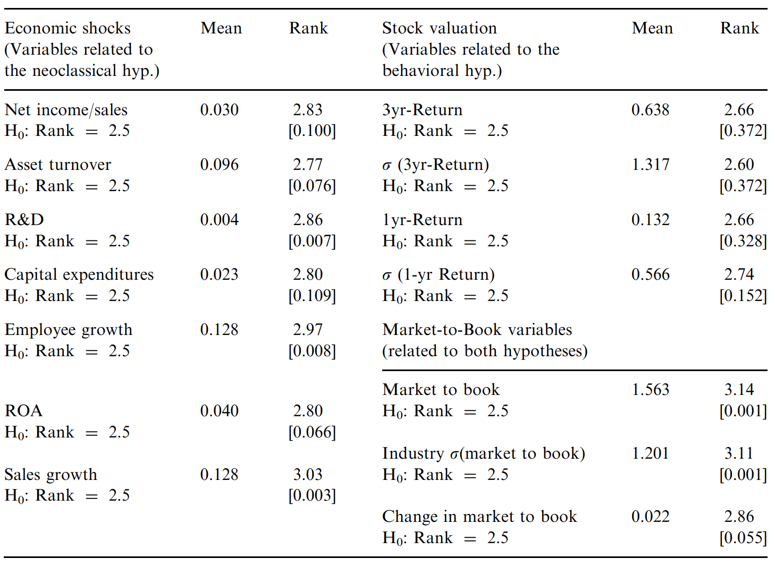
Shocks
WSU
Results
Profitability, Asset Turnover, R&D, CapX, Growth, ROA, and Sales are all abnormally high prior to waves (neoclassical)
Pre-wave changes were high for the average industry (time-series rank)
Variables that are related to both behavioral and neoclassical hypotheses, are all abnormally high in the year preceding a wave

Slide 9
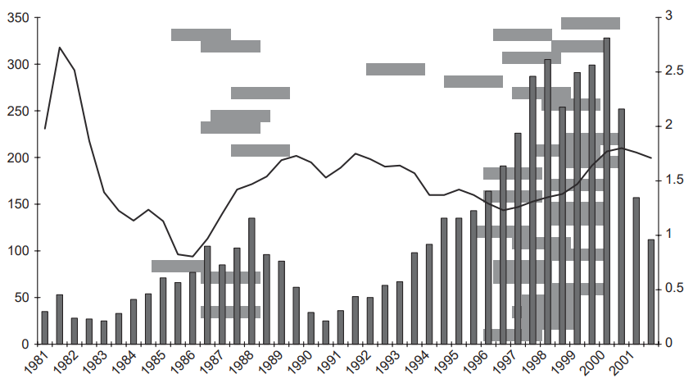
SLO Survey
WSU
Results
“I assert that, based on the results of the Lown et al. paper, the rate spread may be used as a proxy for overall liquidity or ease of financing (in whatever form) in the economy.”
“The neoclassical model with transaction costs”
The rate spread will be correlated with transaction costs
Following the argument that higher asset values accommodate capital liquidity in an industry, the empirical specifications to test the model will also include an industry specific interaction variable
Fig 1 plots an inverse relation between rate spread and aggregate merger activity
Fig 1 also shows bars showing the timing of individual industry merger waves

Slide 10
SLO Survey
WSU
Results

Slide 11
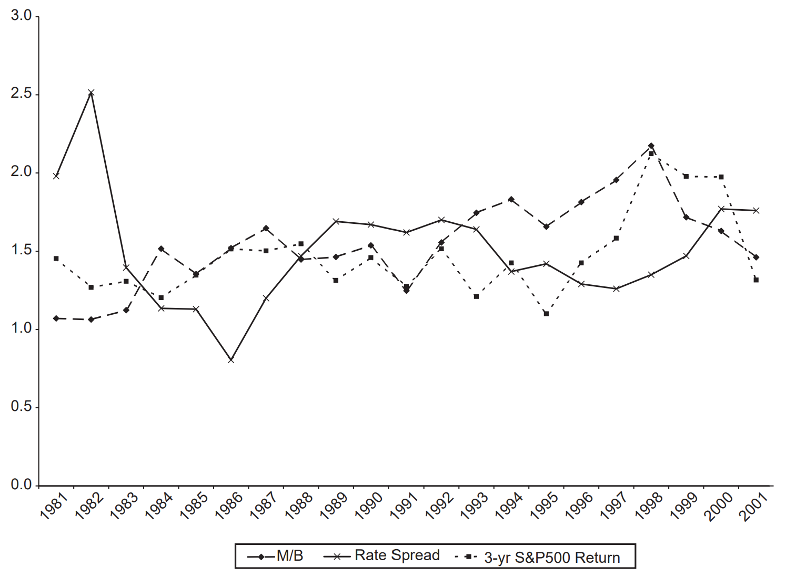
Behavioral Explanation
WSU
Results
Fig 2 suggest that the rate spread leads the market-to-book ratio (decrease in the rate spread leads to increases in the market to book ratio), the correlation between lagged changes in rate spread and the current changes in the market to book ratio is a significant -0.38.
The reverse is not true:
Ergo, transaction costs as a proxy do not correlate with the rate spread

Slide 12



Conclusions
WSU
“The test in this paper directly compare the two explanations and support the neoclassical model, as modified to include a role for capital liquidity.”
The relation between asset values and merger activity that is the motivation of the behavioral hypothesis reflects the capital liquidity effect rather than any misvaluation effect.
Cause for Concern
Acquirer, target, and bids appear rational and binding
First mover(s) vs…?
Evaluates performance in the median, may intra-industry divisions skew this?

